Slide 1

Name: Shashank Baluni

Slide 2

AGENDA
BigMart E-Commerce Store Dashboard
Walkthrough of the Dashboard
Design Principles Followed in the Dashboard
How is BigMart performing?

Slide 3
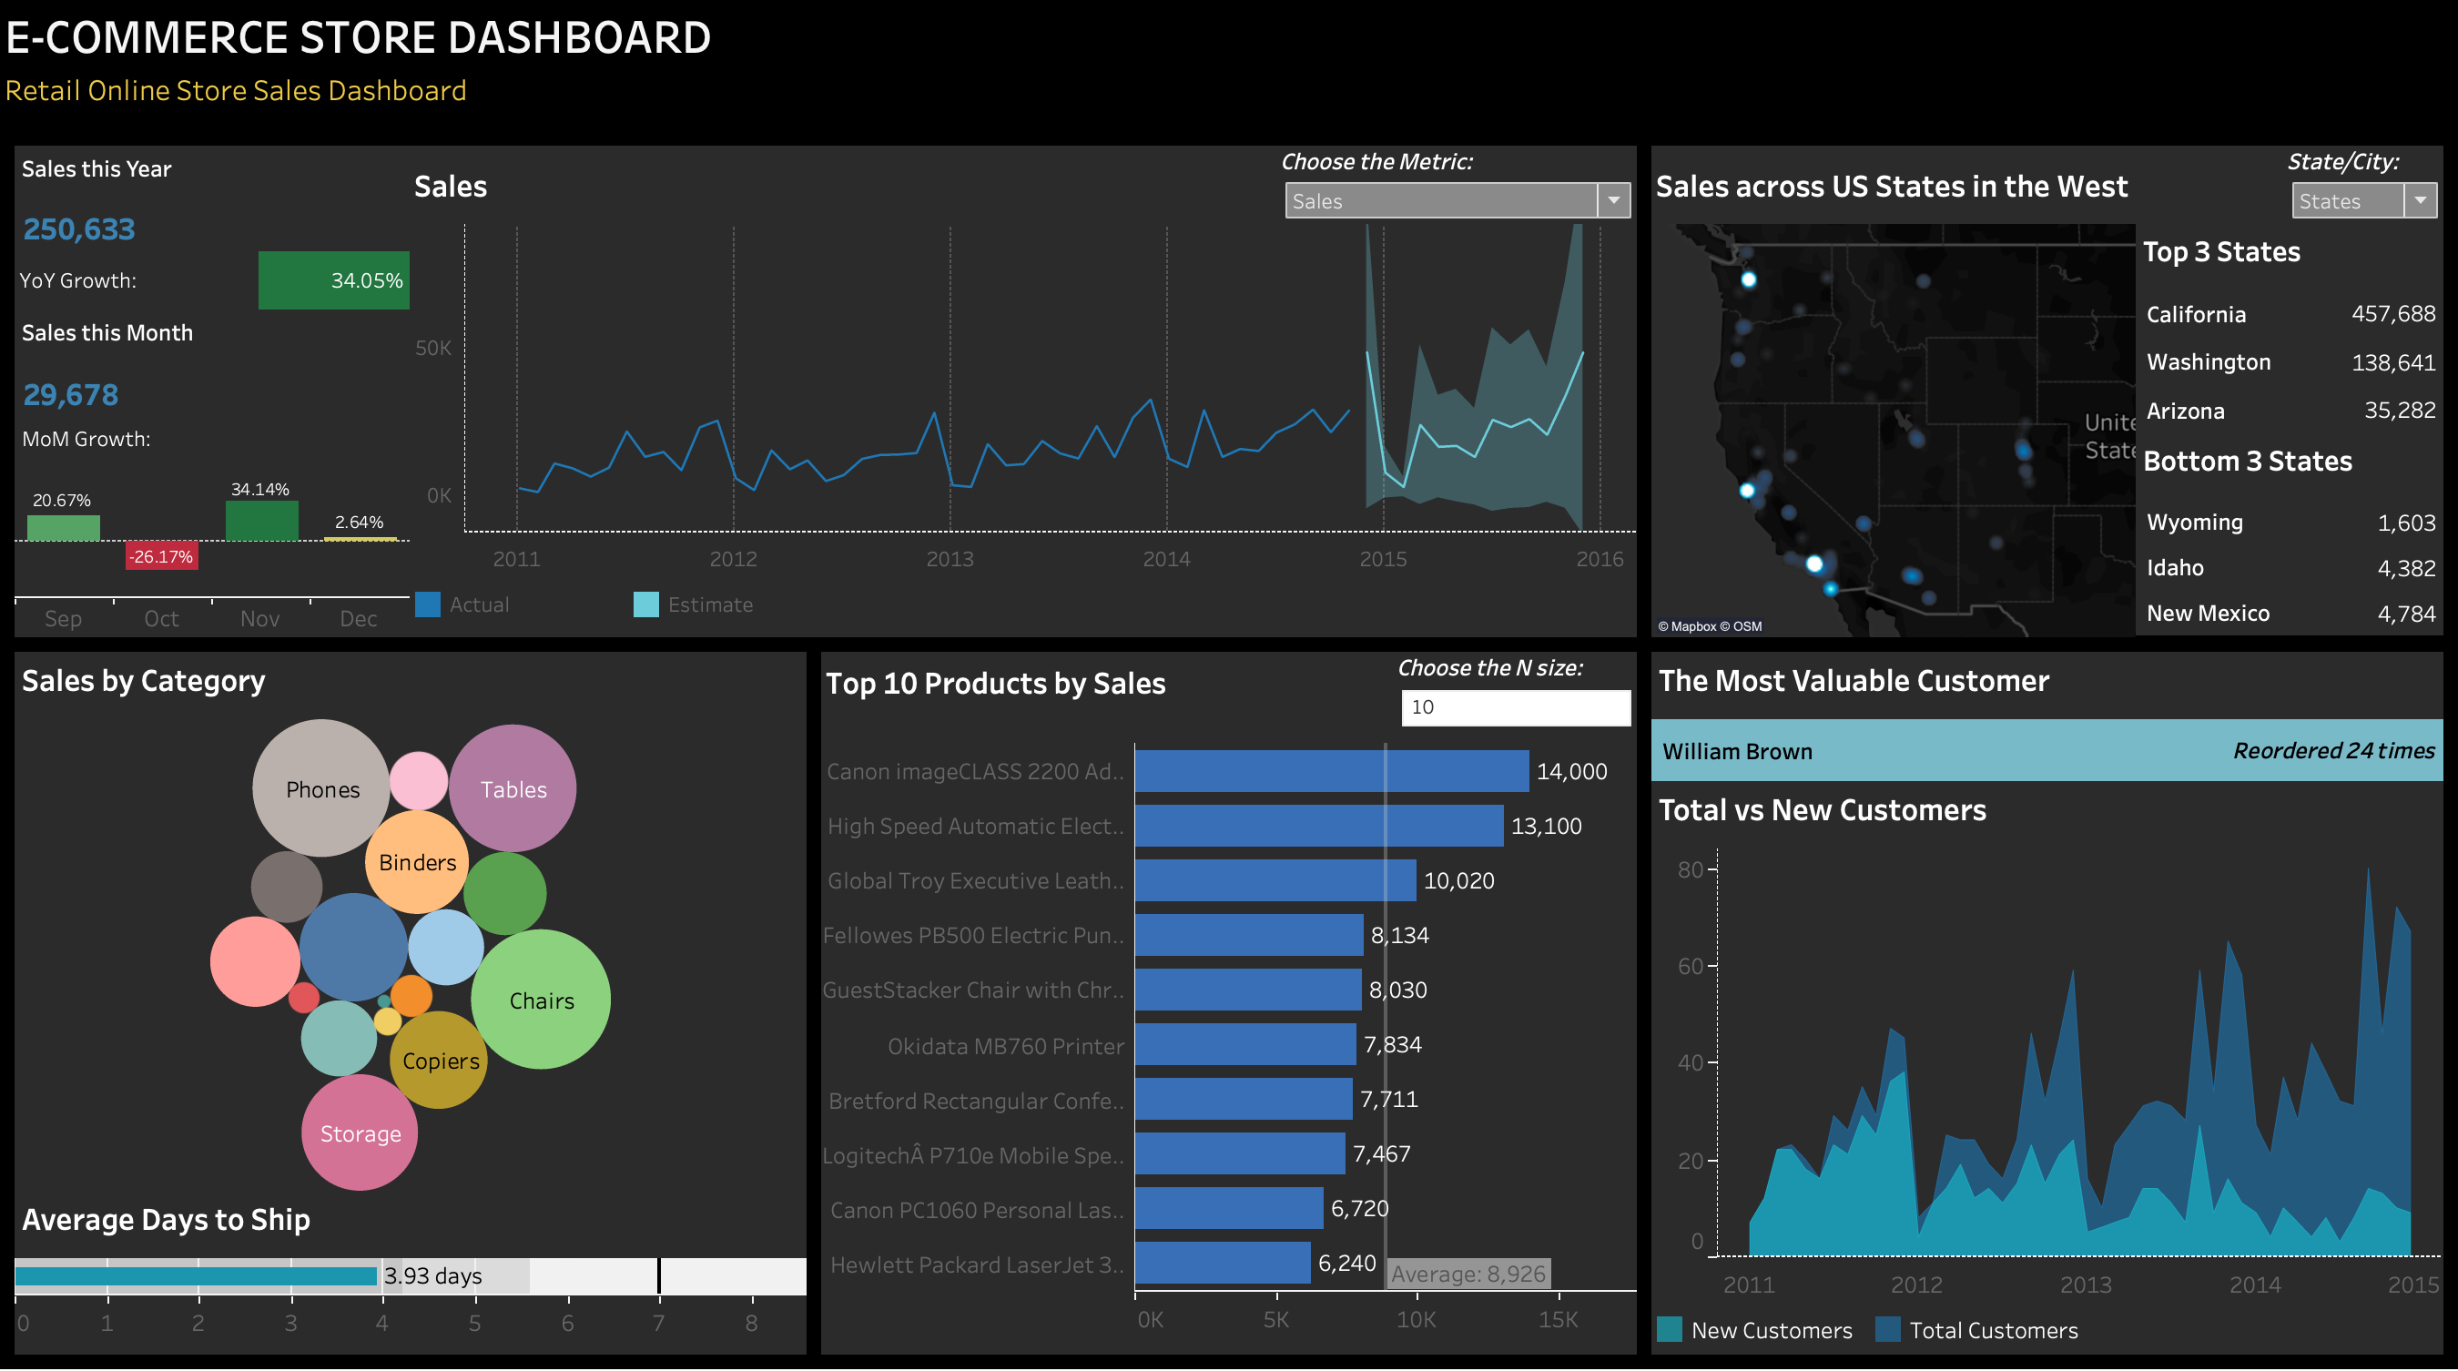
BigMart E-Commerce Store Dashboard
BigMart (fictitious name) is an office supply retail store in the western region of the US and in 2011 they started their online store which sells products ranging from electronics to art supplies. With a vast amount of data at their disposal, they need a way to transform it into actionable insights to make informed business decisions. This dashboard provides a quick and informative overview of the online store's performance, including sales trends, geographic reach, top-selling products, customer behavior, and shipping efficiency.
On day-to-day basis, the interest is in knowing:
Sales trends over time and any trend breaks due to holidays.
Top-performing categories and products.
Most valuable customer, customer acquisition and retention.
Geographical sales distribution with top and bottom performing cities.
Efficiency of order fulfillment (average days to ship since ordered).

Slide 4
Walkthrough of the Dashboard
About the data (Reference: https://www.kaggle.com/datasets)
Sales Data: This dataset includes transaction-level details such as order date, product category, sales amount, profit, quantity sold, and customer details. It was sourced from the client's internal sales database.
Geographical Data: Contains location details of sales transactions, including city and state information, derived from the sales records.
These datasets offer a holistic view of the business, covering sales, customer behavior, and geographical insights.
Monthly Sales Trend and Forecast
Company’s actual monthly sales starting Jan’2011 through Dec’2014 and 12 months of estimated sales for year 2015.
Current Year and Month Sales and YoY and MoM Growth
Company’s sales this year and growth from last year. It also shows sales in the latest month and growth during latest 4 months.
Sales Geographical Distribution
(Density Heatmap)
Sales across cities in the West with white dots highlighting the cities with the highest sales and sales decreases as the gradient of blue color reduces.
Sales by Product Category
Company’s sales by product category with bubble size representing the volume of the sales. It also provides the average times it takes to ship an order with maximum no. of days to ship being 7 days.
Customer Acquisition and Retention
The customer with the highest orders and total and new customers over time.
Top Selling Products
Top 10 Products by sales in descending order.

Slide 5
Design Principles Followed in the Dashboard
Focus on Key Metrics
The dashboard displays a clear selection of metrics relevant to the online store's performance, such as sales growth, top-selling products, and customer behavior. This makes it easy for a user to focus on the key insights.
The use of charts like line chart with estimate, geographical density heat map, bubble chart, bar chart and area chart make the data easy to understand at a glance. Each chart is chosen to display the correct information in a simplest way, and which is easy to interpret.
The information is organized in a logical way, with sections grouped by theme (sales performance, product usage, customer behavior) and arranged in a visually clear layout so that the user is not lost in all the information provided by the dashboard.
Colors are chosen strategically to differentiate sections and highlight important data points. Text is clear and concise, avoiding jargon. Green and red colors in growth are used to show positive and negative change.
The dashboard allows for interactivity, such as filtering data by state, product category or time period, to provide deeper insights. Even using sheets as filters to apply suitable actions to the other relevant sheets. This makes the dashboard more interactive with less messy visuals.
Wherever the text is long to read, proper tooltips are added. For some charts like most valuable customer, there is additional information in the tooltip about the customer acquired date. This helps provide more details with less cluttered views.
The dashboard includes parameters like "Choose the Metric", "State/City", and "Choose N Size". These limit visuals while maintaining functionality to explore various metrics such as sales, profit, profit margin, orders, and customers.
Included minimum days and maximum days to ship benchmarks for average days to ship to inform whether it’s good or bad. Provided historical data for yearly and monthly growth comparison can provide better context for interpreting the store's performance.
Visualized trends in sales and other metrics like profit, orders, customers, etc. over time with trend lines and forecasts to help predict future performance. This also helps to see seasonality in the data like sales are usually higher close to holidays.
The dashboard offers actionable insights for business decisions by highlighting areas of improvement, like the bottom 3 states or cities, and successes, such as top states, most valuable customer, and highest-selling products, to boost and sustain sales.
Visually Appealing Charts
Clear Hierarchy and Layout
Color and Text Usage
Interactivity
Tooltips
Parameters
Comparative Analysis
Trend Lines and Forecasts
Actionable Insights

Slide 6
How is BigMart performing?
Sales Performance
Strong Growth: The store is experiencing significant year-over-year growth (34.05%), indicating a positive sales trend.
Seasonality: The company experiences increase in sales in December before holidays and decrease in sales in January and February post holidays.
2015 Estimated Sales: The sales forecast of the company shows an overall positive trend with similar seasonal patterns.
Top Performing Regions
Top State: California is the leading state in terms of sales volume, highlighting a potential regional strength.
Top Cities: Los Angeles, Seattle and San Francisco are the top 3 cities with the highest sales.
Bottom State: There is a very minimal contribution of sales from Wyoming which has the least sales.
Top Selling Categories and Products
Top Category: Chairs and Phones have the highest sales over time, highlighting them as the most popular categories among customers.
Top Product: Canon Advanced Copier has the highest sales over time making it customers’ all time favorite.
Customer Behavior
Loyal Customer Base: The "Most Valuable Customer" section with a high reorder count suggests a loyal customer base, which is valuable for repeat business.
By leveraging these key insights and exploring the data further, the online retail store can make data-driven decisions to:
Optimize marketing strategies for wider geographic reach.
Focus on high-performing product categories or identify opportunities within underperforming ones.
Improve the customer experience through faster or more affordable shipping options.
This will ultimately lead to continued growth and success for the online retail store.
Future Enhancements:
Geographic Reach: While the top states and cities are displayed, analyzing sales growth by region might reveal underperforming areas for targeted marketing efforts.
Product Category Insights: The bubble chart for sales by category offers a limited view. A deeper dive into category performance, including growth rates or sub-category analysis, could identify areas for improvement or promotion.
Delivery Optimization: The average days to ship is a basic metric. Examining shipping costs or customer satisfaction with delivery speed could provide a more holistic view of the fulfillment process.

